Slide 1
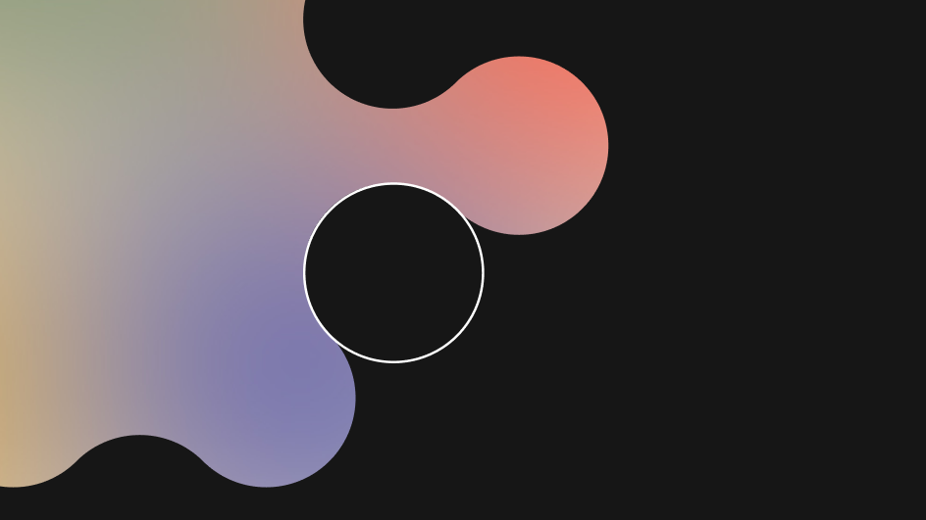



Open-Source AI Night December 4, 2024

Slide 2

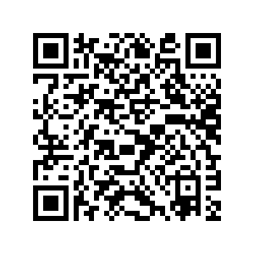

Slide 3
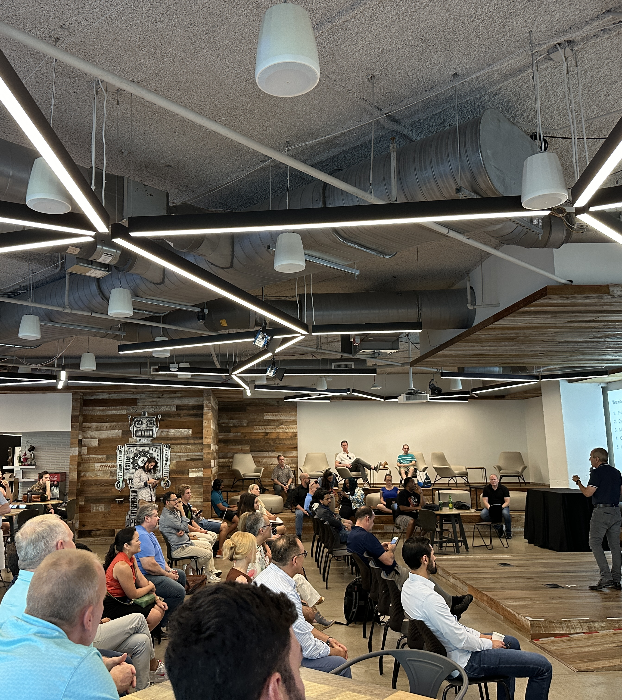
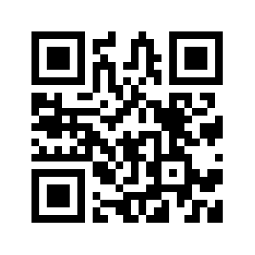
Get involved in the Austin AI Alliance!
The Austin AI Alliance brings together companies, universities, non-profits, professional associations, and AI professionals to advance awareness, development, and responsible usage of AI.
Our next meeting is December 18, 2024, where we’ll wrap up the year and offer a glimpse into 2025.
Get your free ticket and learn how to get your organization involved at https://www.austin-ai.org .

